Slide 1

DAX : Data Analysis Expressions
is a formula expression language
DAX formulas include functions, operators, and values
Creates new information from data already in your model
DAX formulas are used to create
Measures
Calculated Columns
Calculated Tables
All the computations are generated at Data Model

Slide 2
DAX : Data Analysis Expressions
Measures
dynamic calculation formulas resulting in a single value
Performed at the time of data analysis
Respond to user interactions, such as filtering, drilling down, or slicing data
Calculated Columns
a column that you add to an existing table
a DAX formula defines the column's values based on existing columns in the dataset
Computed during data refresh
Static and cannot be changed based on user interactions
Calculated Tables
Table computed using DAX formulas
Not present in original data source data source but are created based on existing data and calculations

Slide 3
Power BI Accounts and Pricing

Slide 4
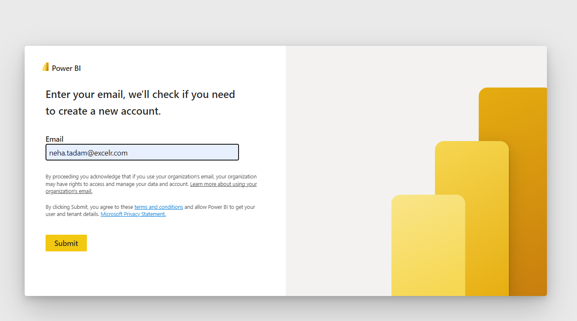

Slide 5
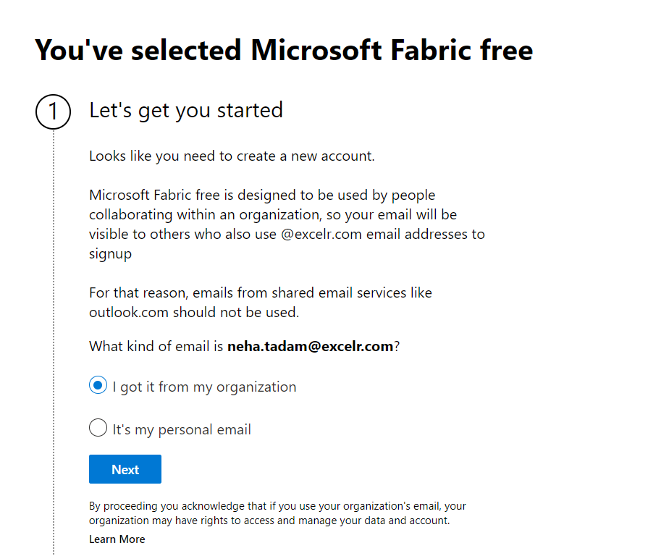

Slide 6
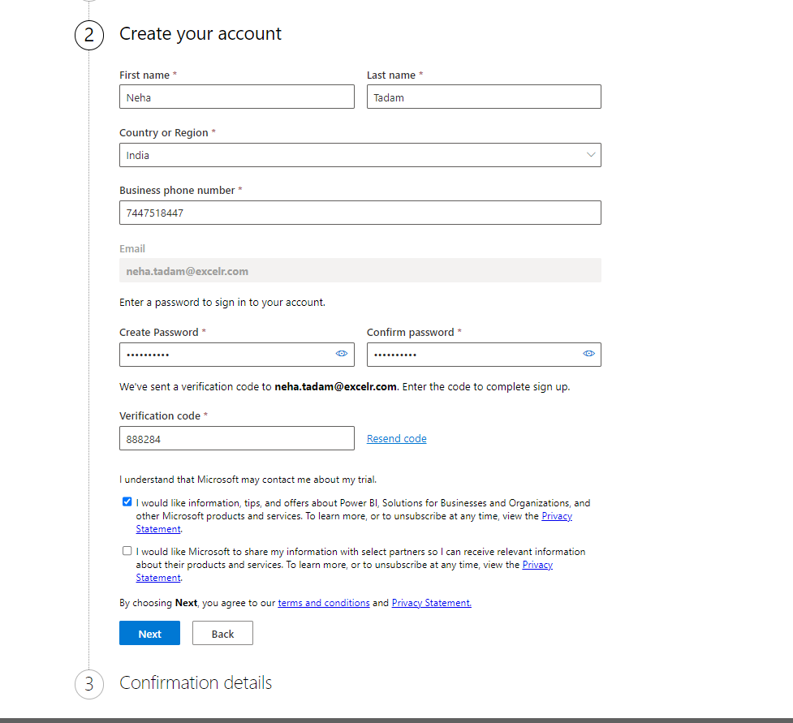

Slide 7
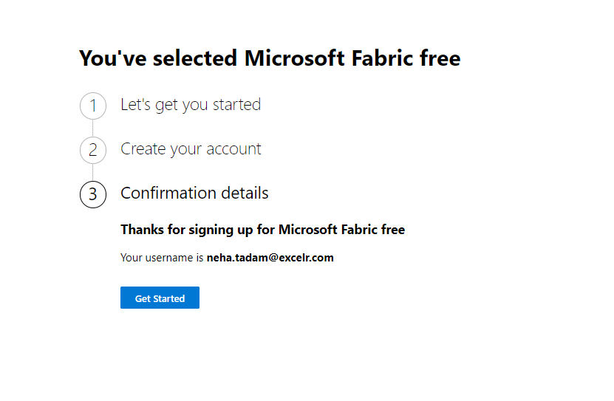

Slide 8
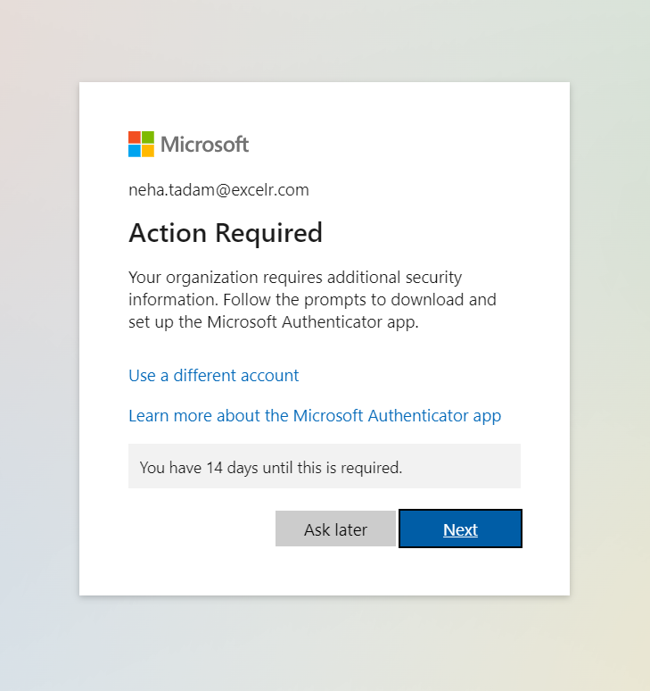

Slide 9
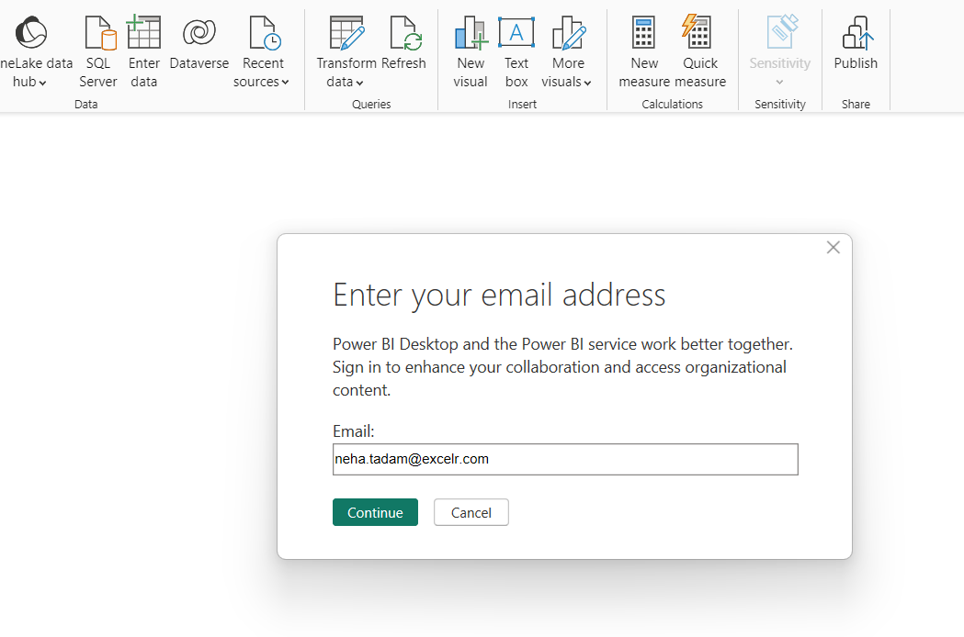

Slide 10
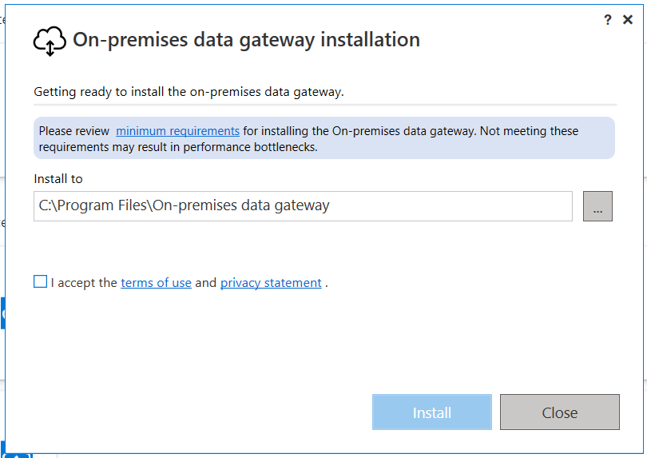
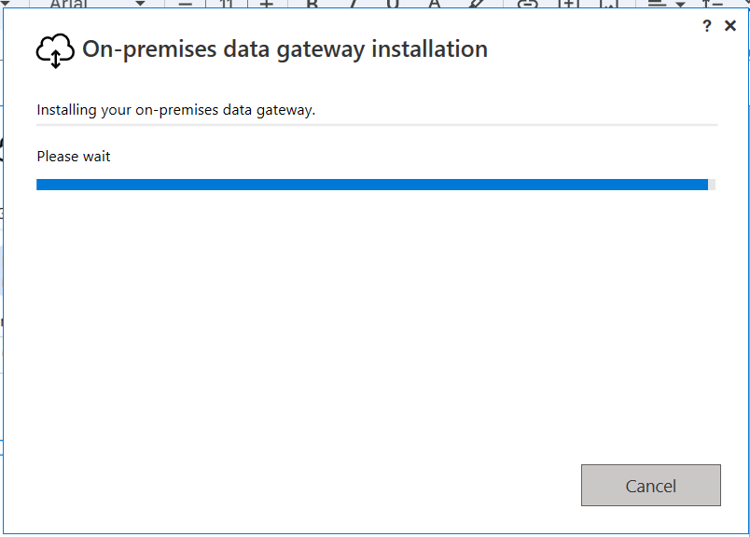
Step 1
Step 2

Slide 11
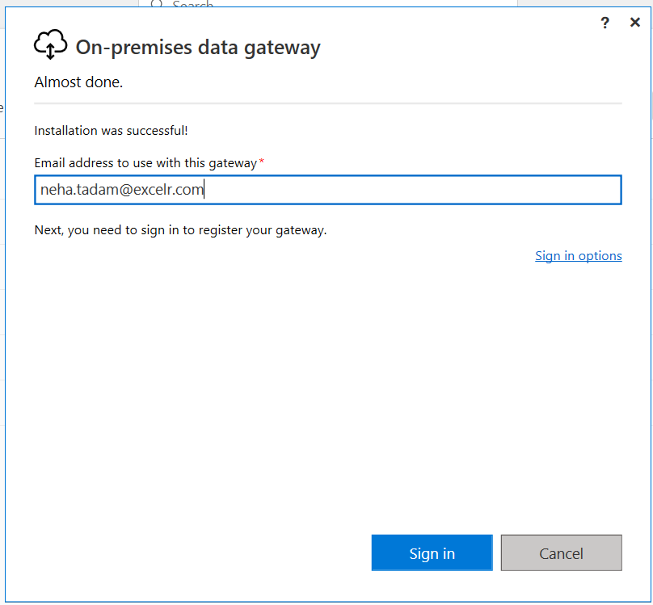
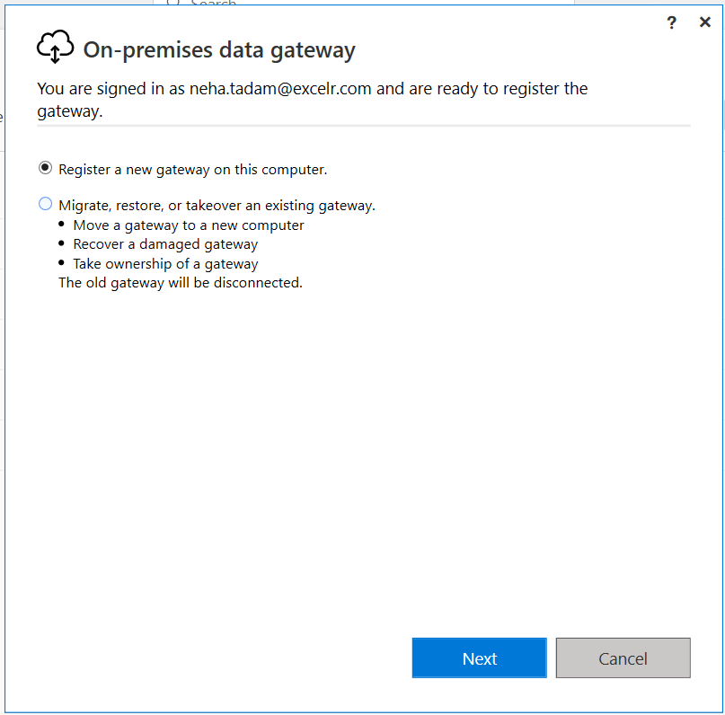
Step 3
Step 4

Slide 12
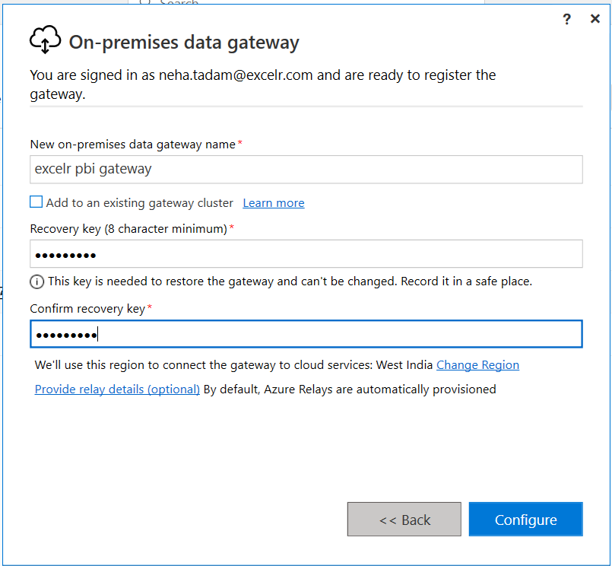
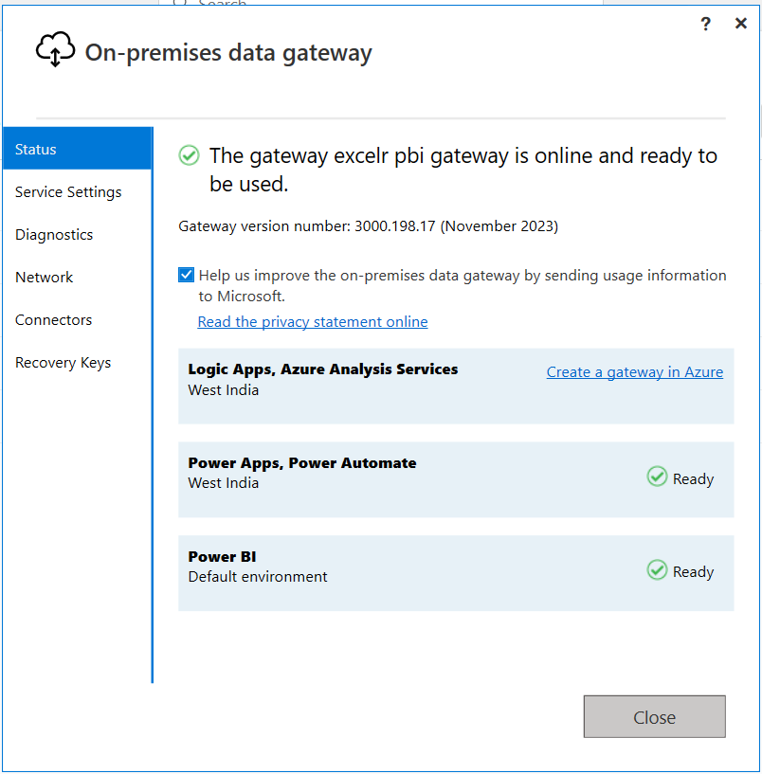
Step 5
Step 6

Slide 13
Data
Number types
Date/Time types
Text type
True/false type
Binary type

Slide 14
How to extract data in Power BI?

Slide 15
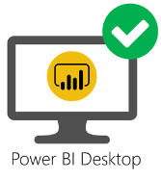
How to extract data in Power BI?
Data source

Slide 16

How to extract data in Power BI?
Data source
Connectors

Slide 17
How to extract data in Power BI?
Data source
Connectors
Software components that establish the connection between Power BI and the specific data source.

Slide 18

Excel workbook
Connector
Data source

Slide 19

Database
Connector
Data source

Slide 20

Text/CSV Connector
Data source

Slide 21
Connectivity Modes

Slide 22







Connectivity Mode | Report | Data | Model
Import (small data size) | PBI Desktop | Copy | PBI Desktop
Direct Query (Large Data size) | PBI Desktop | Data Source | PBI Desktop
Live Connection (Real-time-Analysis) | PBI Desktop | Data Source | Data Source

Slide 23
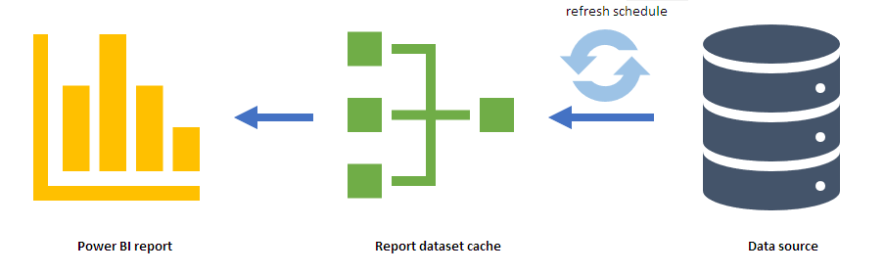
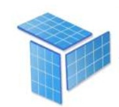
1. Import Mode
2. DirectQuery
Mode
Data Copy
3. Live Connection
Mode
Import is a method that gets a copy of data from the data source into Power BI
Refresh data to load data changes
Dataset Limit is 1 GB

Slide 24
1. Import Mode
2. DirectQuery
Mode
Data Copy
3. Live Connection
Mode
Import is a method that gets a copy of data from the data source into Power BI
Refresh data to load data changes
Dataset Limit is 1 GB

Slide 25
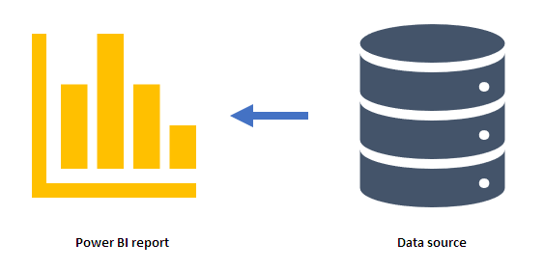
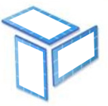
1. Import Mode
Schema
2. DirectQuery
Mode
DirectQuery is a method you can use to connect your semantic model to data
3. Live Connection
Mode
Use Cases:
You're working against data sources with a large volume of data
You want to use 'near real-time' data

Slide 26
1. Import Mode
Live connection is a way of connecting a Power BI report to a published Power BI dataset.
2. DirectQuery
Mode
Data sources:
A semantic model that already exists in Power BI service
An Azure Analysis Services (AAS) database
An on-premises instance of SQL Server Analysis Services (SSAS)
3. Live Connection
Mode

Slide 27
Loading Data From a Folder

Slide 28
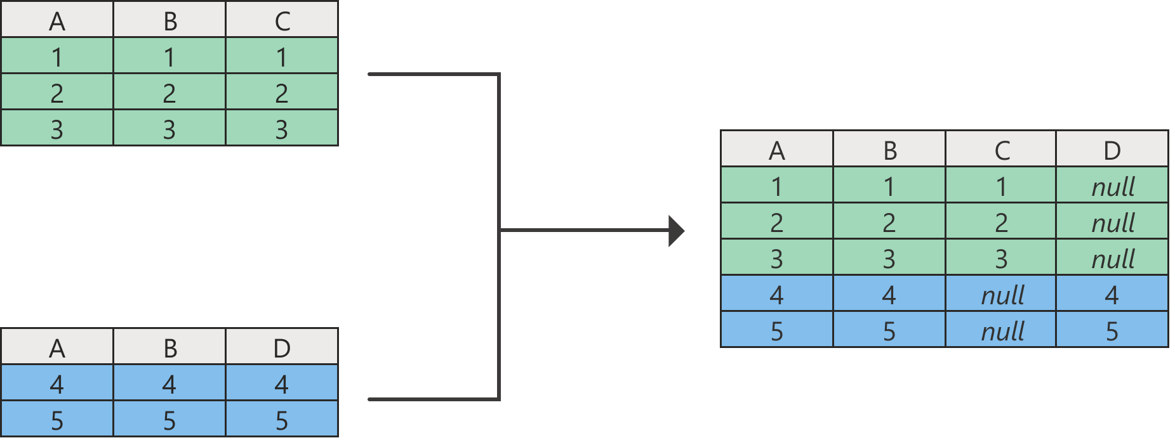
Append Queries

Slide 29
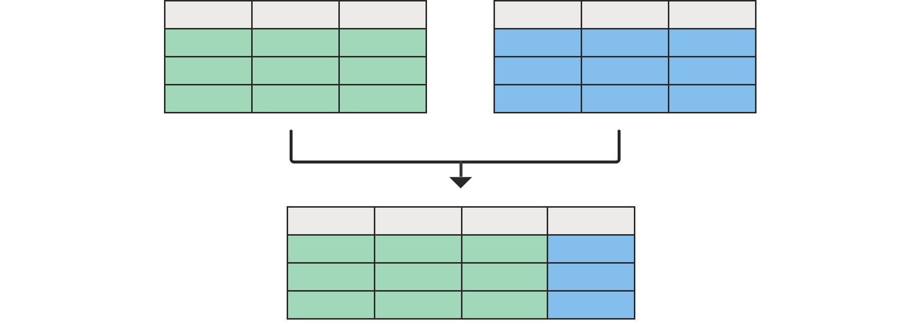
Merging Queries

Slide 30
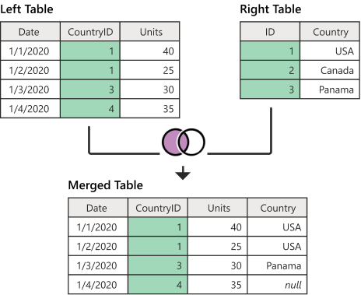
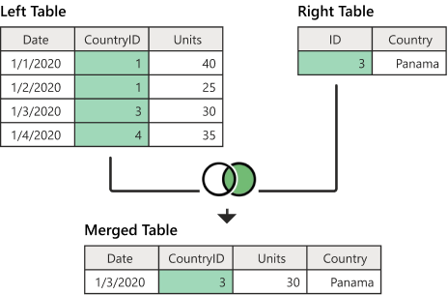
Left outer join
Right outer join

Slide 31
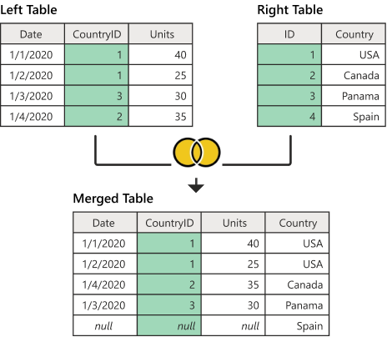
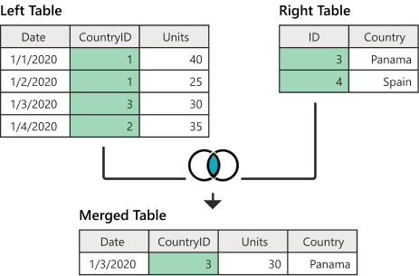
Full outer join
Inner join

Slide 32
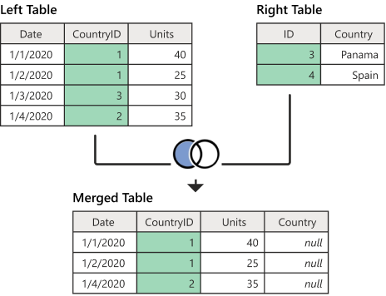
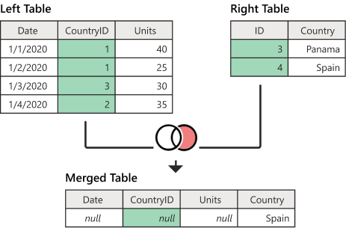
Left anti join
Right anti join

Slide 33
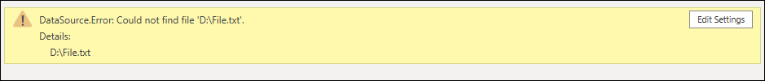
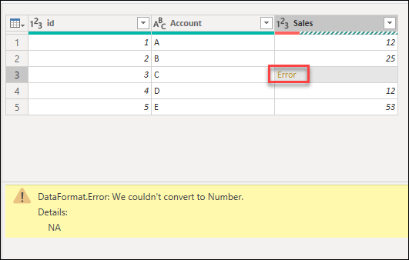
Errors in Power Query Editor

Slide 34
Errors in Power Query Editor
1
Step-level error
2
Cell-level error

Slide 35
Errors in Power Query Editor
1
Step-level error
Keep Errors
Rename Errors
Remove Errors
2
Cell-level error

Slide 36
Filtering :
Visual Interaction
Slicers
Drill Through
Drill Down
Filters Plane
Include / exclude

Slide 37
Pivoting :
Moving rows to columns to see different summaries of the source data.
Month | Category | Sales
July | Bikes | 2000
July | Accessories | 500
August | Bikes | 2500
August | Accessories | 300
Month | Bikes | Accessories
July | 2000 | 500
August | 2500 | 300

Slide 38
Pivoting :
Moving rows to columns to see different summaries of the source data.
Month | Category | Sales
July | Bikes | 2000
July | Accessories | 500
August | Bikes | 2500
August | Accessories | 300
Month | Bikes | Accessories
July | 2000 | 500
August | 2500 | 300
Category | July | August
Bikes | 2000 | 2500
Accessories | 500 | 300

Slide 39
UnPivoting :
Moving columns to rows to see different summaries of the source data.
Month | Bikes | Accessories
July | 2000 | 500
August | 2500 | 300
Month | Category | Sales
July | Bikes | 2000
July | Accessories | 500
August | Bikes | 2500
August | Accessories | 300

Slide 40
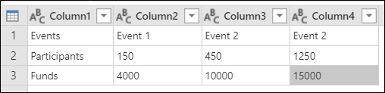
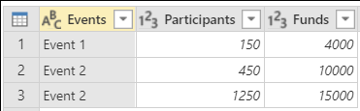
Transpose :
Turns rows into columns and columns into rows.

Slide 41
Transpose :
Turns rows into columns and columns into rows.

Slide 42
Transpose :
Turns rows into columns and columns into rows.

Slide 43
Transpose :
Turns rows into columns and columns into rows.

Slide 44
Transpose :
Turns rows into columns and columns into rows.

Slide 45
Transpose :
Turns rows into columns and columns into rows.

Slide 46
Transpose :
Turns rows into columns and columns into rows.

Slide 47
Fact tables
Dimension tables
store observations or events
Examples:
sales orders,
stock balances,
exchange rates,
temperatures, etc.
describe business entities
Examples:
products,
people,
places, and
concepts including time itself..

Slide 48
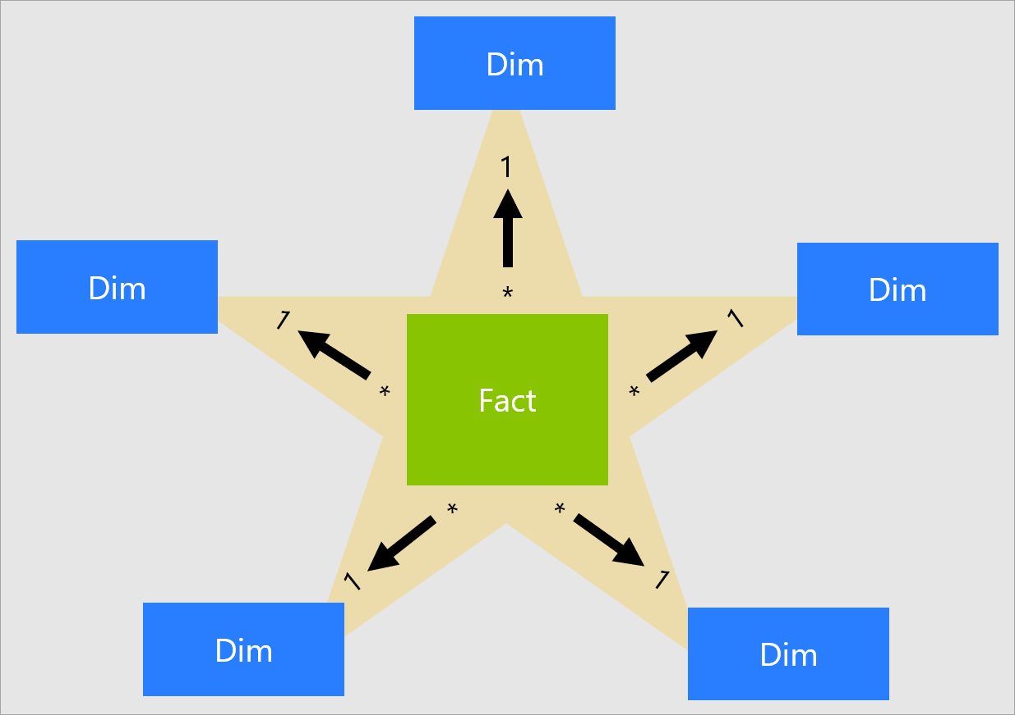
Star schema

Slide 49
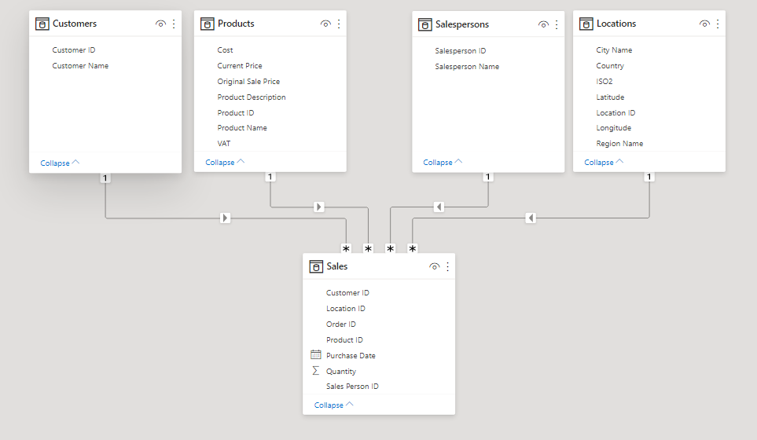
Star schema

Slide 50
Star schema

Slide 51
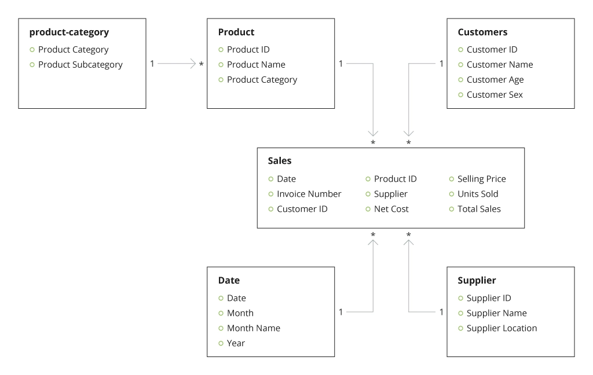
Snowflakes schema
Gender

Slide 52
Snowflakes schema
Gender

Slide 53
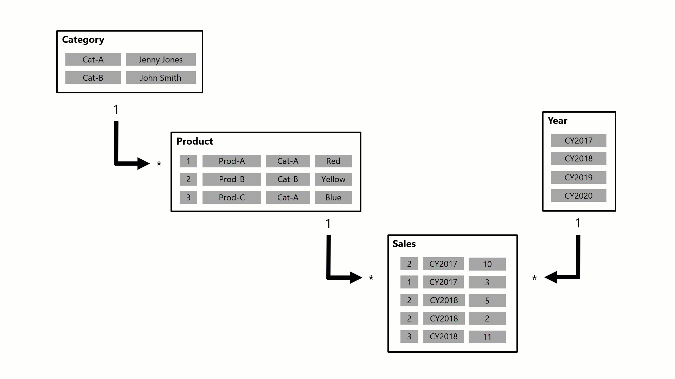

Slide 54
Exploring In-Depth Insights
In Power BI, there are several features and techniques to explore insights in-depth.
Some key approaches within Power BI:
Drill Down
Drill Through
Tool Tips
Navigating from summarized data to more detailed levels within the same visualization.
Moving to a dedicated page with detailed information specific to a data point in a report.
Displaying additional information upon hovering over a data point in a visualization, providing on-demand insights.

Slide 55
Exploring In-Depth Insights
In Power BI, there are several features and techniques to explore insights in-depth.
Some key approaches within Power BI:
Drill Down
Drill Through
Tool Tips
Navigating from summarized data to more detailed levels within the same visualization.
Moving to a dedicated page with detailed information specific to a data point in a report.
Displaying additional information upon hovering over a data point in a visualization, providing on-demand insights.

Slide 56
Exploring In-Depth Insights
In Power BI, there are several features and techniques to explore insights in-depth.
Some key approaches within Power BI:
Drill Down
Drill Through
Tool Tips
Navigating from summarized data to more detailed levels within the same visualization.
Moving to a dedicated page with detailed information specific to a data point in a report.
Displaying additional information upon hovering over a data point in a visualization, providing on-demand insights.

Slide 57
Exploring In-Depth Insights
In Power BI, there are several features and techniques to explore insights in-depth.
Some key approaches within Power BI:
Drill Down
Drill Through
Tool Tips
Navigating from summarized data to more detailed levels within the same visualization.
Moving to a dedicated page with detailed information specific to a data point in a report.
Displaying additional information upon hovering over a data point in a visualization, providing on-demand insights.

Slide 58
Visual Filtering
Visual Interaction
Slicers
Filters Plane
Interaction with one chart filters data in other charts to display only related information.
interactive buttons on the report page that, when used, filter and focus on specific data, allowing users to customize their view.
Tool that allows you to control the displayed information on individual visuals, entire pages, or the entire report

Slide 59
Visual Filtering
Visual Interaction
Slicers
Filters Plane
Interaction with one chart filters data in other charts to display only related information.
interactive buttons on the report page that, when used, filter and focus on specific data, allowing users to customize their view.
Tool that allows you to control the displayed information on individual visuals, entire pages, or the entire report

Slide 60
Visual Filtering
Visual Interaction
Slicers
Filters Plane
Interaction with one chart filters data in other charts to display only related information.
Interactive buttons on the report page that, when used, filter and focus on specific data, allowing users to customize their view.
Tool that allows you to control the displayed information on individual visuals, entire pages, or the entire report

Slide 61
Visual Filtering
Visual Interaction
Slicers
Filters Plane
Interaction with one chart filters data in other charts to display only related information.
interactive buttons on the report page that, when used, filter and focus on specific data, allowing users to customize their view.
Tool that allows you to control the displayed information on individual visuals, entire pages, or the entire report

Slide 62
Examples:
Top 5 Subcategories by Sales
Subcategories with total sales greater than 1L
Subcategories with total sales between than 0.5L to 1L
Subcategories with total
total sales greater than 1L or
total quantity ordered greater than 1k
Products from Subcategories - Caps and gloves
Products that are fit for S/M/L
Top selling product with description

